Slide 1

MSCI 534 – Optimisation & Heuristics
MSCI 535 – Optimisation with Financial Applications
Lecture 15
Richard Eglese
Department of Management Science
Lancaster University Management School

Slide 2
Dynamic Programming
Dynamic Programming (DP) is a mathematical technique which can be used when we need to make a sequence of decisions.
“Programming” means planning here.
But DP can be performed by a computer.
In fact it can be done on a spreadsheet.
Formal definitions and mathematical notation will be given later.
But first we consider some example problems.
See Example 1 from the Dynamic Programming Lecture Notes.

Slide 3
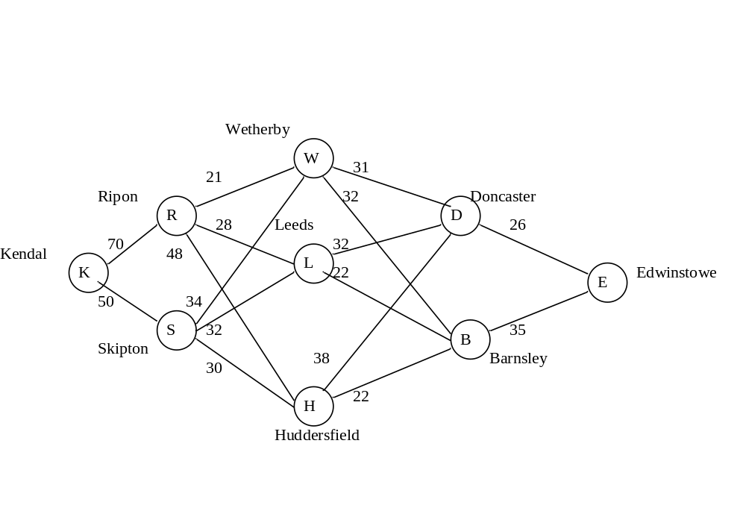
Example 1 – Shortest Path

Slide 4
Principle of DP
Bellman’s (1957) Principle of Optimality:
“An optimal policy has the property that whatever the initial state and initial decision are, the remaining decisions must constitute an optimal policy with regard to the state resulting from the first decision.”

Slide 5
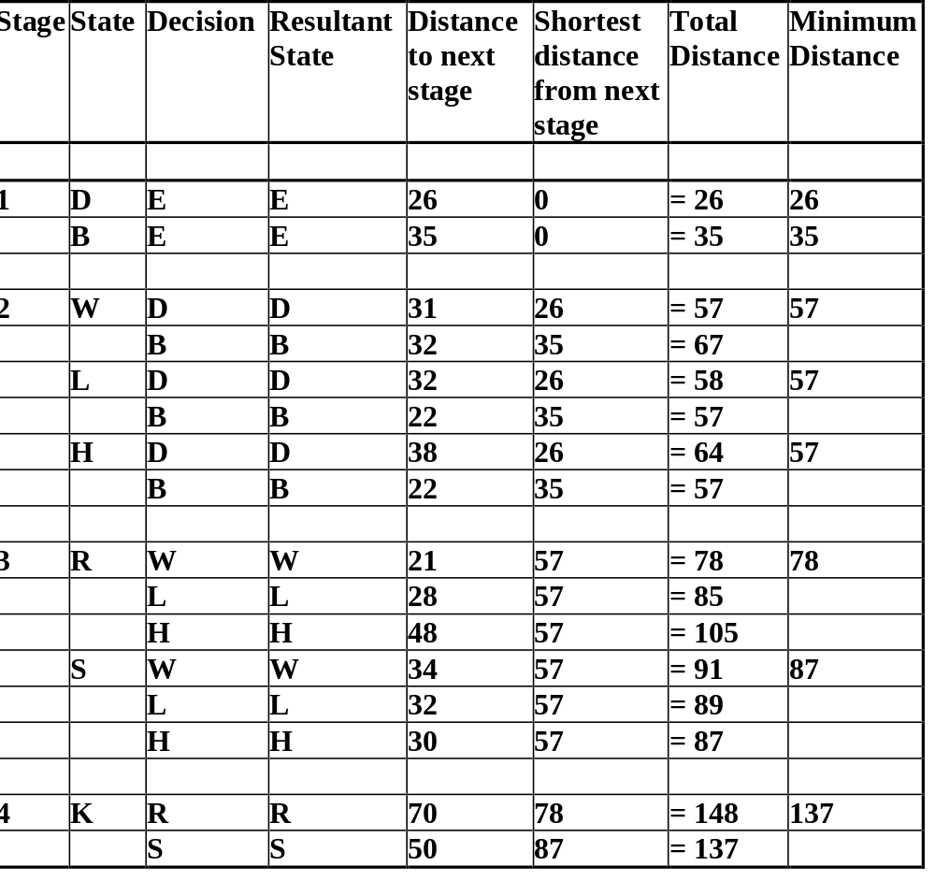
Table of calculations

Slide 6
Example 2: A Production Planning Problem
See page 5 of the lecture notes for details

Slide 7
Key formulation questions
What are the stages?
What are the states?
What are the decisions?
What are the immediate returns or costs from this decision?
What state will I be in at the next stage after the decision?

Slide 8
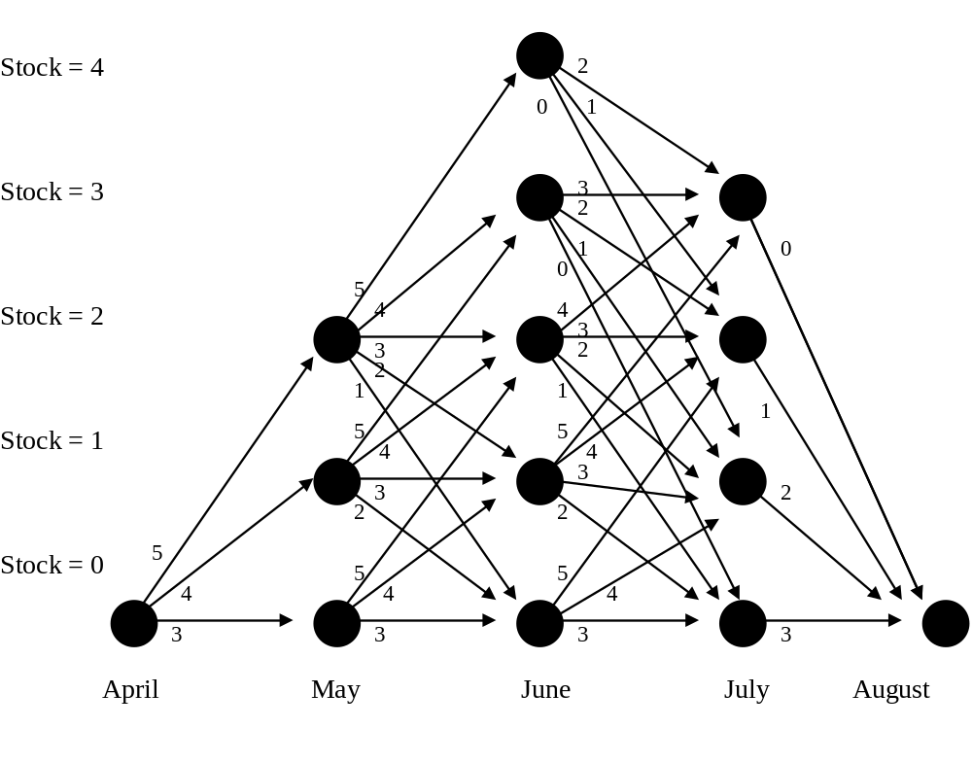
Representation of structure

Slide 9
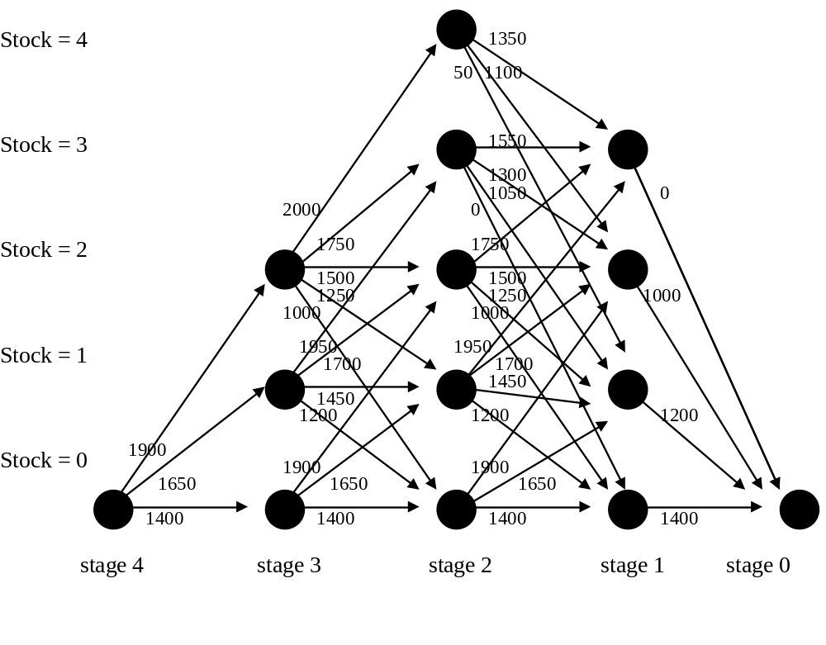
Structure with costs

Slide 10
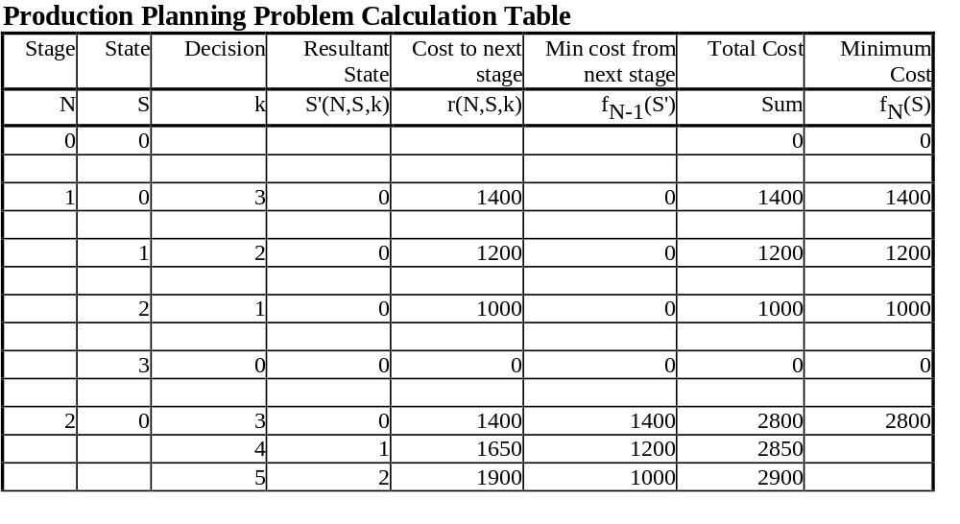
Initial calculations

